Slide 1
The Visual Display
of Quantitative Information
Edward R. Tufte
Presented By:
Ali Khalid & Cydnelle Alemao

Slide 2
Overview
Graphical Practice
Graphical Excellence
Graphical Integrity
Sources of Graphical Integrity and Sophistication
Theory of Data Graphics
Data-Ink and Graphical Redesign
Charijunk: Vibrations, Grids, and Ducks
Data-Ink Maximization and Graphical Design
Multifunctioning Graphical Elements
Data Density and Small Multiples
Aesthetics and Technique in Data Graphical Design

Slide 3
Graphical Excellence
Guidelines
Show the data
Induce the viewer to think about substance
Avoid distorting data
Present many numbers in a small space
Make large data sets coherent
Encourage visual comparisons
Reveal data at multiple levels of detail
Serve a clear purpose
Integrate closely with text descriptions

Slide 4
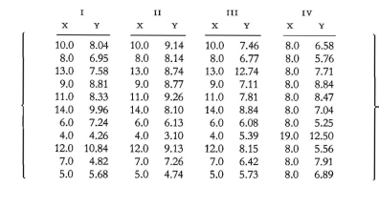
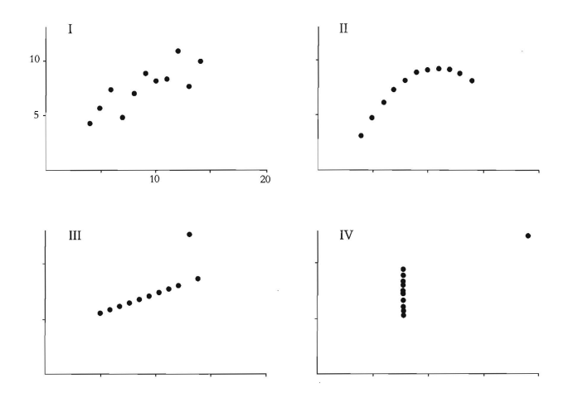
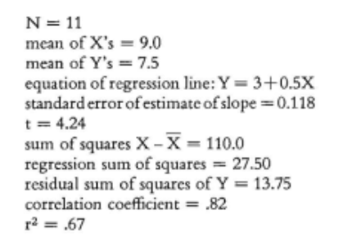
Anscombe’s Quartet
Described by the same Linear Model

Slide 5
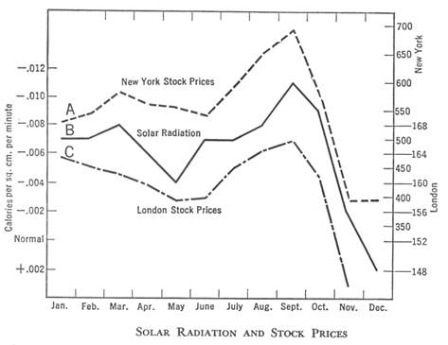
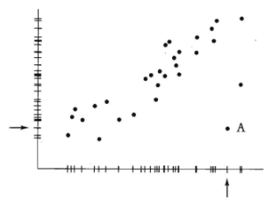
Graphical Display of Data
Outliers can be spotted easily
Data should be reasonable

Slide 6
Graphical Excellence
Fundamental Graphic Designs:
Data Maps:
Spatial distribution of additional information over a geographical diagram
Time Series:
Data is plotted over a period of time
Space-Time Narrative Designs:
Data is plotted over space and time
Relational Graphics:
Displays the relationship between multiple data aspects

Slide 7
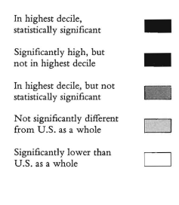
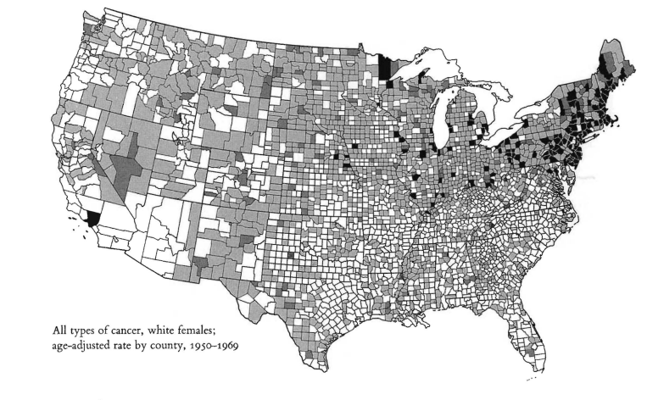
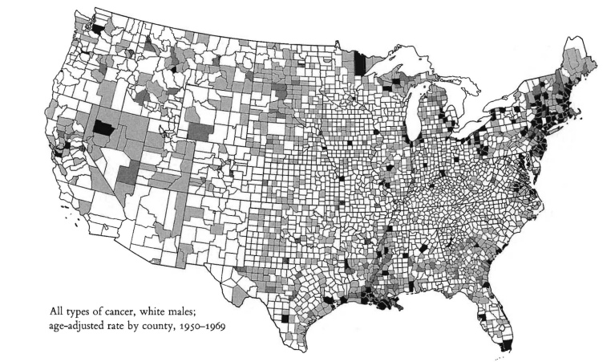
Data Maps
Age-adjusted death rates by cancer type for USA counties

Slide 8
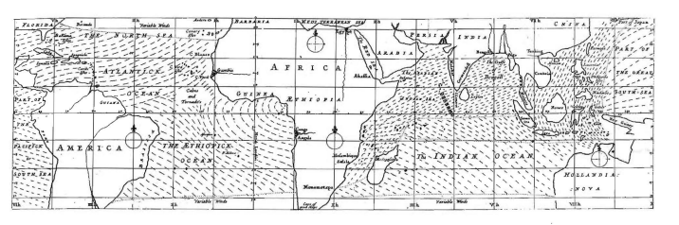
Data Maps
One of the first data maps
Edmond Halley’s Map (1686) represents trade winds and monsoon

Slide 9
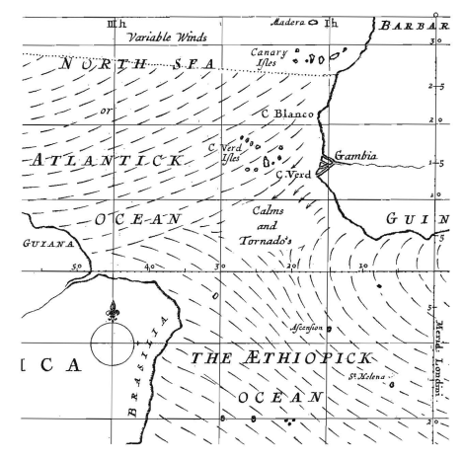
Data Maps
The sharp end of each stroke represents
the direction from where the wind
continually comes

Slide 10
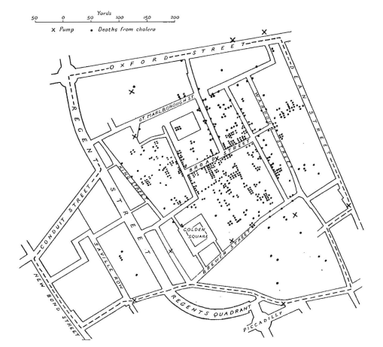
Data Maps
Deaths from cholera in
central London for September 1854
Dots - Deaths
Cross - Water pumps

Slide 11
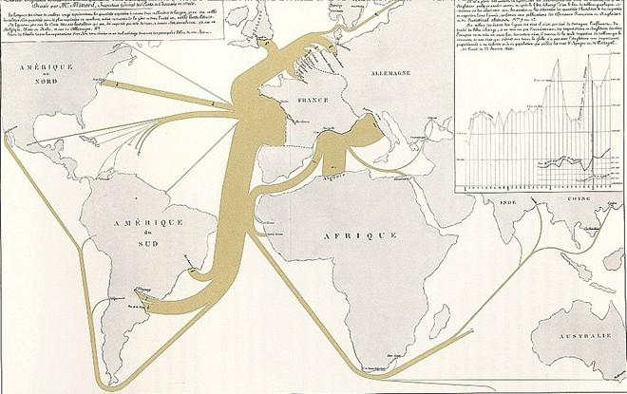
Data Maps
Exports of French Wine
(1864)
Displays direction and
quantity

Slide 12
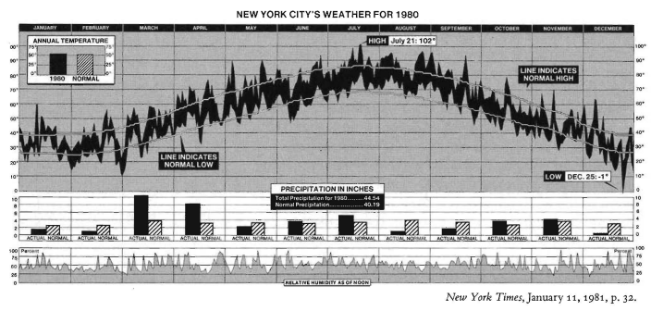
Time Series
New York City weather

Slide 13
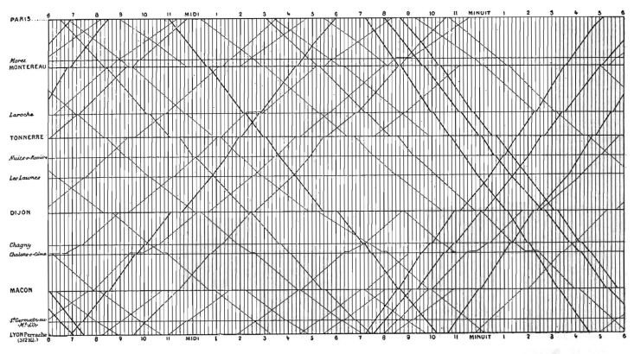
Time Series
Schedule of trains
from Paris to Lyon
Time and distance

Slide 14
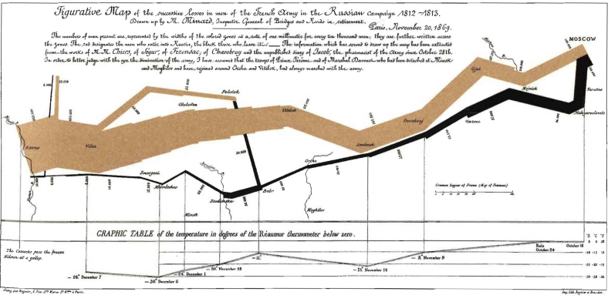
Space - Time Narrative
Napoleon's army in Russia

Slide 15
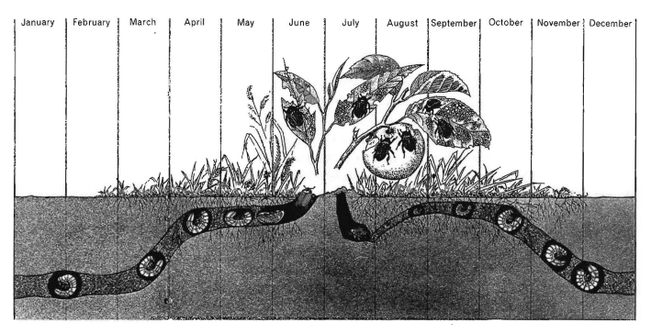
Space - Time Narrative
The life cycle of the Japanese beetle
Location relative to ground surface, and
Time are represented

Slide 16
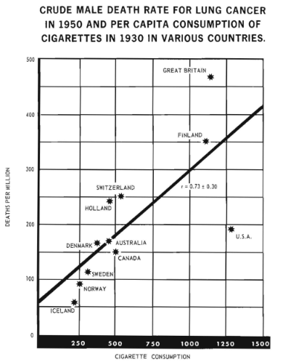
Relational Graphics
It links at least two variables
Encourages the viewer to assess the
possible causal relationship between
the plotted variables

Slide 17
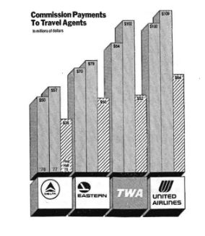
Graphical Integrity
Principles of Graphical Integrity
The representation of numbers, as physically measured on the surface of the graphic itself, should be directly proportional to the numerical quantities represented.
Clear, detailed, and thorough labeling should be used to defeat graphical distortion and ambiguity. Write out explanations of the data on the graphic itself. Label important events in the data.

Slide 18
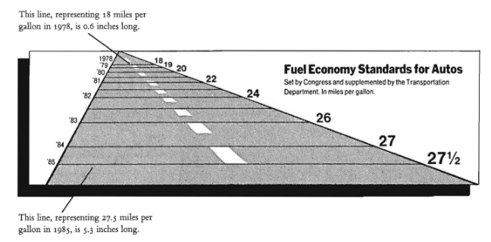
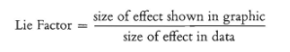
Lie Factor
Horizontal lines represent the Magnitude of change

Slide 19
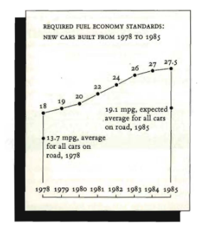
Graphical Integrity
Tufte’s “Non-Lying” Alternative

Slide 20
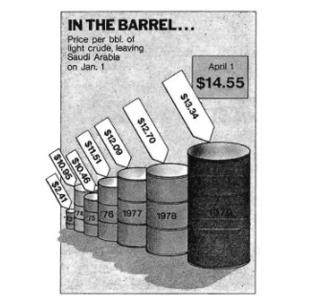
Graphical Integrity
Principles of Graphical Integrity
3) Show data variation, not design variation

Slide 21
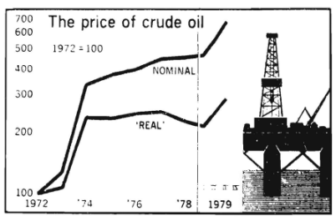
Graphical Integrity
Principles of Graphical Integrity
4) In time-series displays of money, deflated and standardized units of monetary measurement are nearly always better than nominal units.
Real = Inflation-adjusted comparison
5) The number of information-carrying (variable) dimensions depicted should not exceed the number of dimensions in the data.

Slide 22
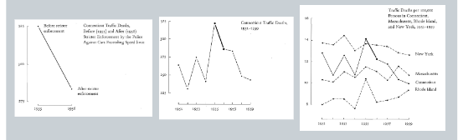
Graphical Integrity
Principles of Graphical Integrity
6) Graphics must not quote data out of context.

Slide 23
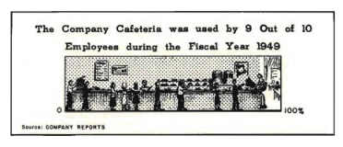
Sources of Graphical Integrity and Sophistication
Why do artists in major newspaper and magazines misrepresent data or “lie”?
Professional artist lacks the required quantitative skills.
Belief that statistical data is “boring” leading to exaggeration of data.
Belief that graphics are only for unsophisticated readers.

Slide 24
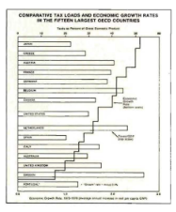
The consequences….
Over-decorated and simplistic designs.
Use of tiny data sets.
Discrepancies in information communicated leading to “big lies”.
Use of Bivariate data in a univariate design to avoid the finer details of a scatter plot.

Slide 25
Theory of Data Graphics
Everyone spoke of an information overload, but what there was in fact was a non-information overload.
Richard Saul Wurman, What-If, Could-Be (Philadelphia, 1976)

Slide 26
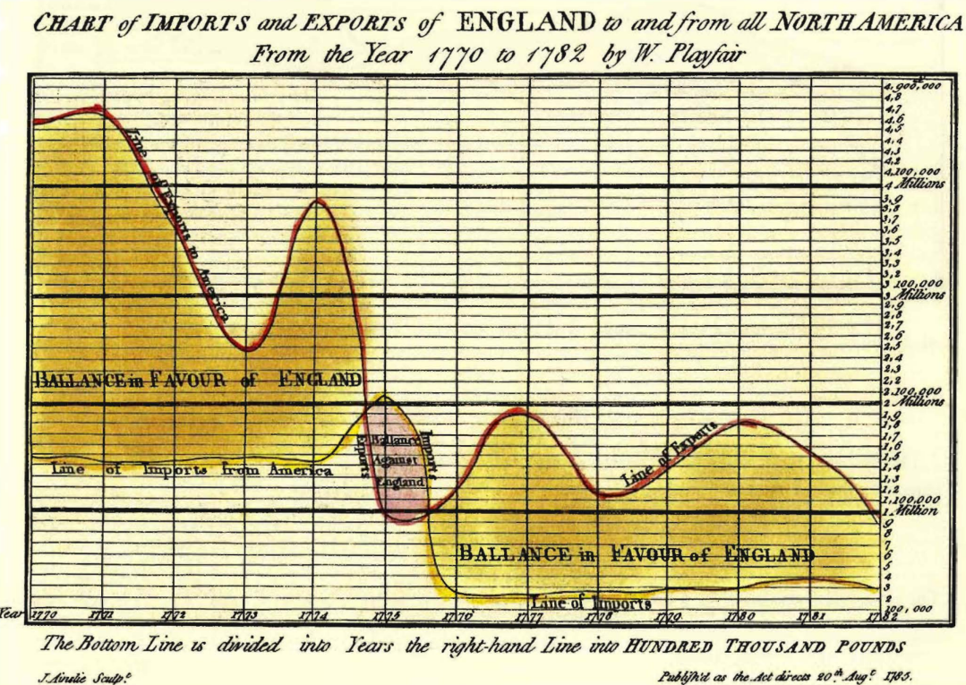
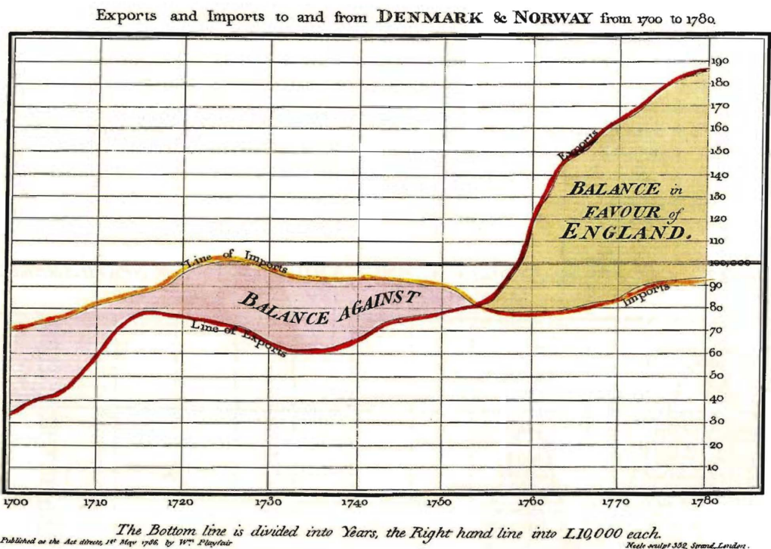
Data-Ink and Graphical Redesign
Above all else show the data.
❌
✔

Slide 27
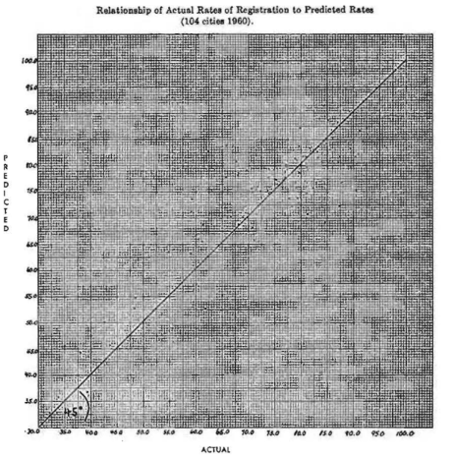
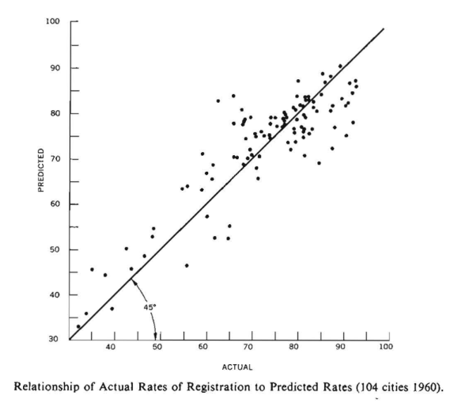
Data-Ink and Graphical Redesign
Maximize the data-ink ratio, within reason.
Data-ink ratio = data-ink / total ink used to print the graphic
Erase non-data-ink, within reason.
Erase redundant data-ink, within reason.
❌
✔

Slide 28
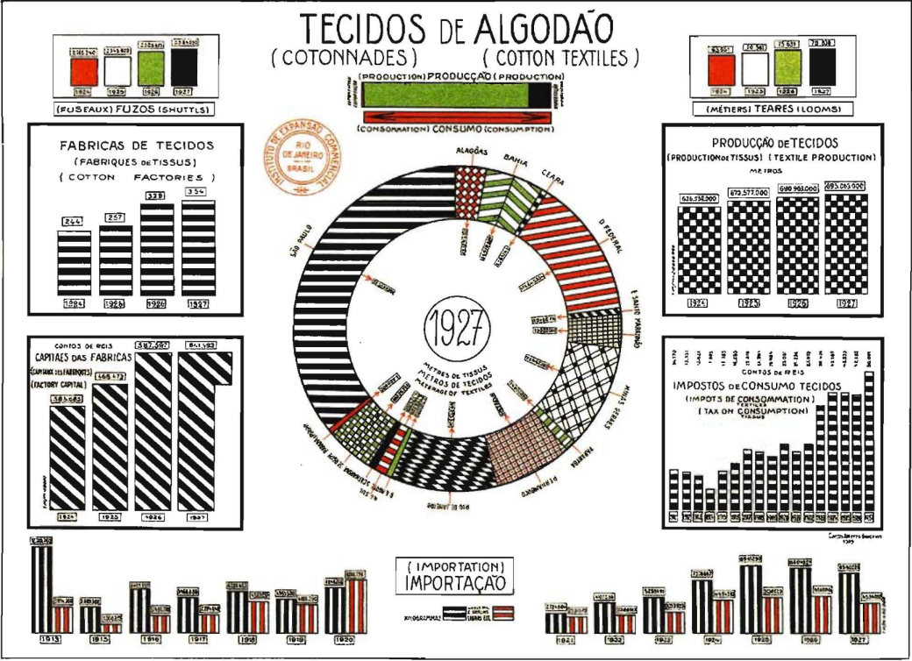
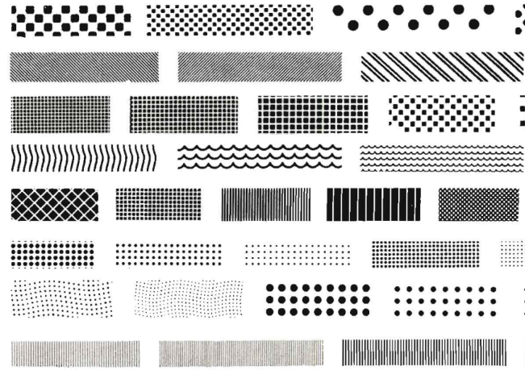
Chartjunk: Vibrations, Grids, and Ducks
Vibrations (moire effects)
Bad Data Graphics

Slide 29
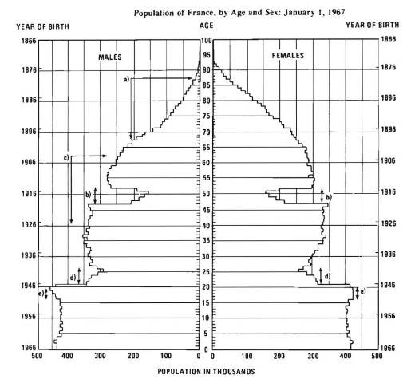
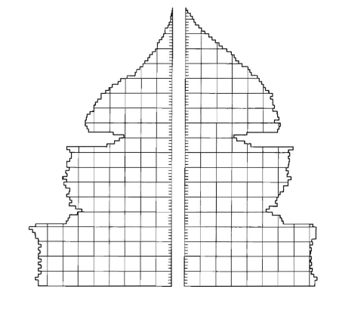
Chartjunk: Vibrations, Grids, and Ducks
Grids
✔
❌

Slide 30
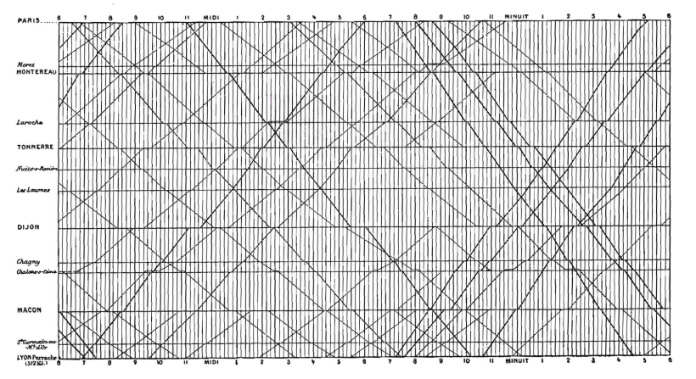
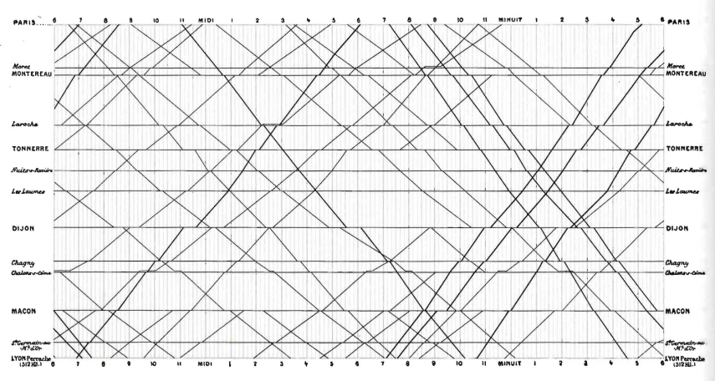
Chartjunk: Vibrations, Grids, and Ducks
Grids
❌
✔

Slide 31
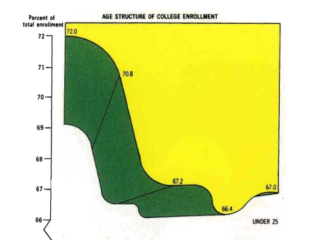
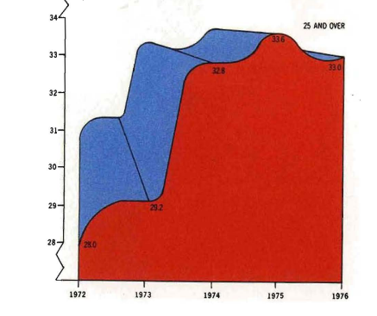
Chartjunk: Vibrations, Grids, and Ducks
Ducks (Self-Promoting Graphics)

Slide 32
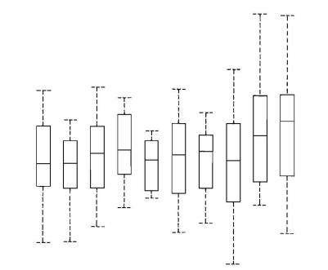
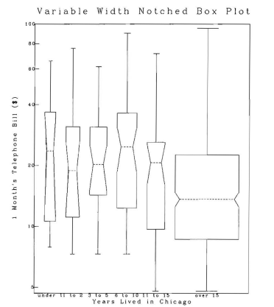
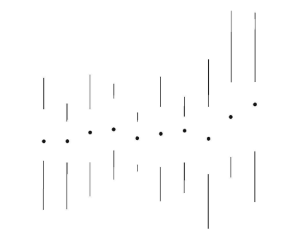
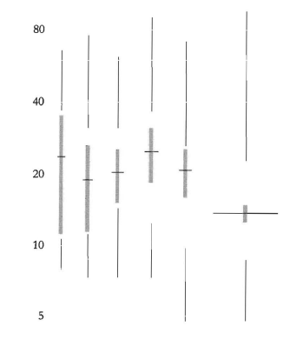
Data-Ink Maximization and Graphical Design
❌
❌
✔
✔
Box Plot
Notched Box Plot

Slide 33
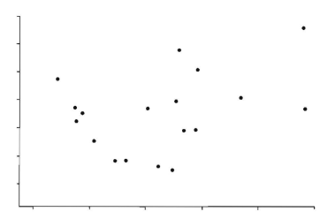
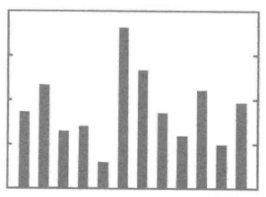
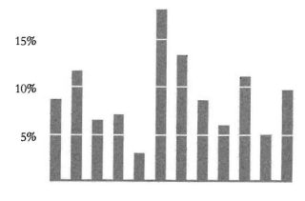
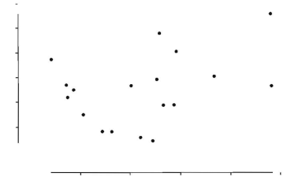
Data-Ink Maximization and Graphical Design
❌
❌
✔
✔
Histogram / Bar Chart
Scatter Plot

Slide 34
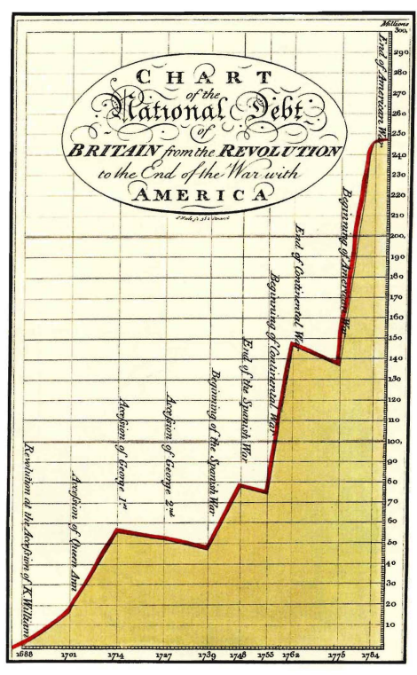
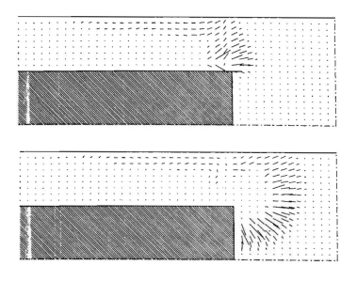
Multifunctioning Graphical Elements
Data-Based Grids

Slide 35
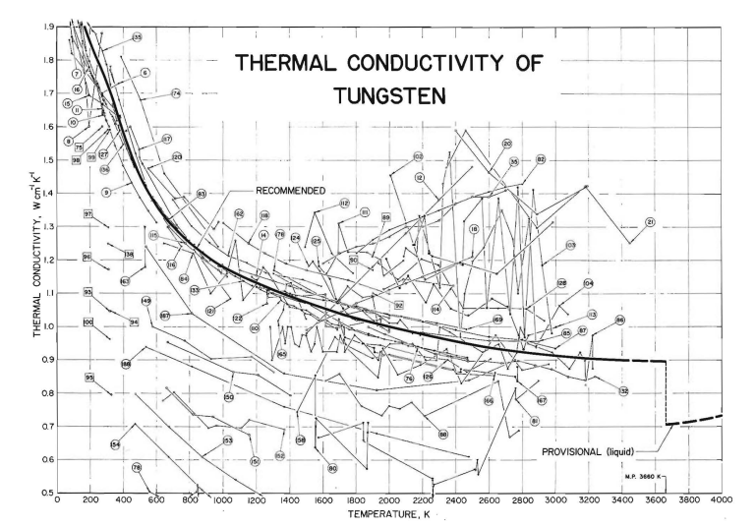
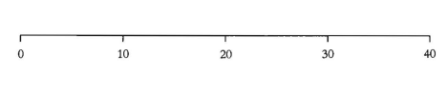

Multifunctioning Graphical Elements
Double-Functioning Labels

Slide 36


Data Density and Small Multiples
data density = number of entries in data matrix / area of data graphic
❌
✔

Slide 37


Data Density and Small Multiples
Small multiples

Slide 38



Aesthetics and Technique in Data Graphical Design
Graphical elegance is often found in simplicity of design and complexity of data.

Slide 39



Aesthetics and Technique in Data Graphical Design
Golden Rectangle: the smaller is to the greater part as the greater is to the whole
The nice geometry of the Golden Rectangle is not unique.

Slide 40
Conclusion
Not to rely on any of the doctrines that professional artists might believe about graphics.
Not allowing artists/illustrators to control and design statistical graphs by themselves. Substantive and quantitative expertise is also important (not only artistic) if both statistical integrity and graphical sophistication is to be achieved.

Slide 41


